Slide 1
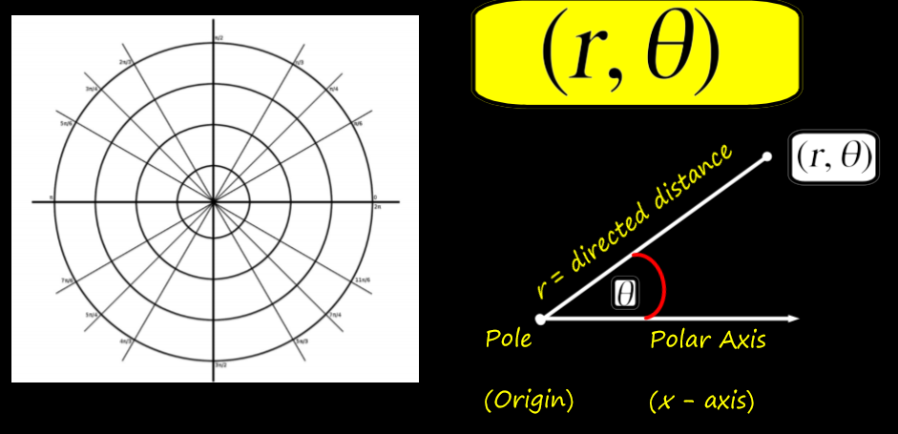
10.7 Polar Coordinates

Slide 2
Definitions/ Characteristics
Polar coordinates: a 2nd way to plot points using a directed angle and a directed distance.
Written as: (r, ϴ) where r is the radius (distance) and ϴ is the angle
Uses concentric circles and angles in standard position
Each point can have may different polar coordinates to represent it (unlike rectangular coordinates- which only have 1)

Slide 4
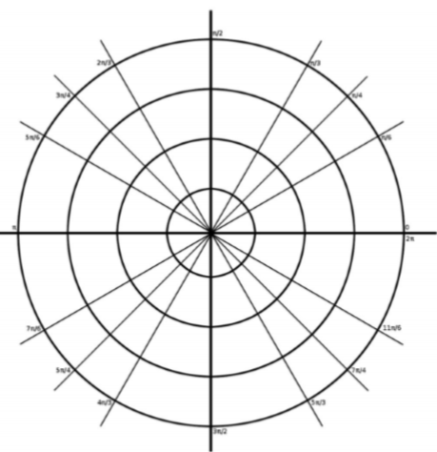
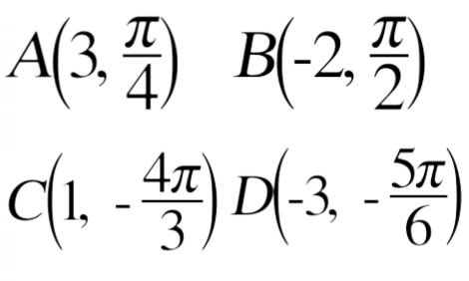
Graphing Polar Coordinates

Slide 5
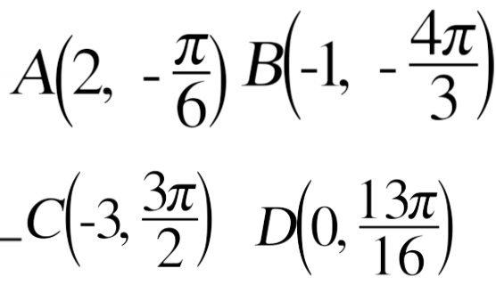
Graphing Polar Coordinates

Slide 6
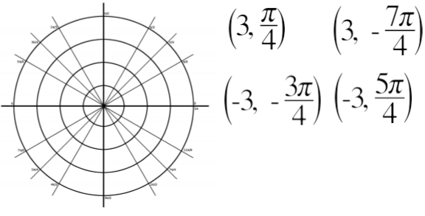
Multiple Representations of Polar Coordinates

Slide 7
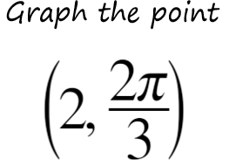
Multiple Representations of Polar Coordinates

Slide 8
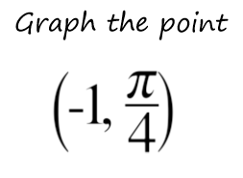
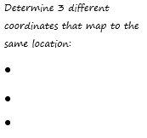
Multiple Representations of Polar Coordinates

Slide 9
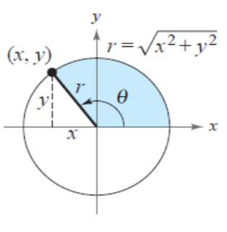
Conversions

Slide 10
Converting: Polar to Rectangular Coordinates

Slide 11
Converting: Polar to Rectangular Coordinates

Slide 12
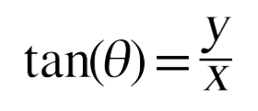
Converting: Rectangular to Polar Coordinates

Slide 13
Converting: Rectangular to Polar Coordinates

Slide 14
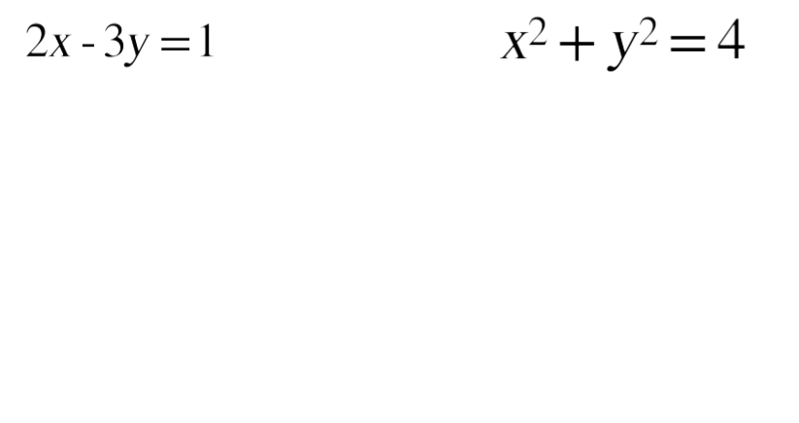
Converting Equations: Rectangular to Polar
Steps:
Substitute for x and y
Solve for “r”

Slide 15
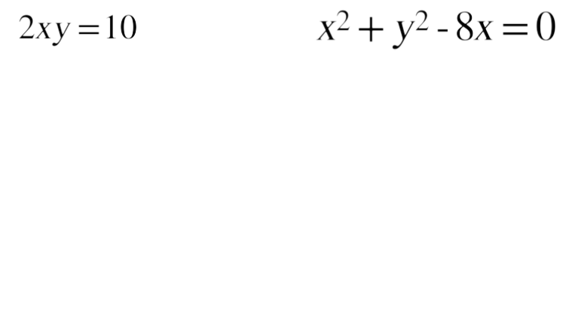
Converting Equations: Rectangular to Polar

Slide 16
Converting Equations: Polar to Rectangular
Must think to solve these- manipulate the equation to match with one of the four equations used to convert points
1.) r = 2 2.) $θ=\frac{π}{3}$ 3.) $r=secθ$

Slide 17
More examples
4.) r = 1 5.) $θ= \frac{π}{4}$ 6.) $r=cscθ$

Slide 18
Practice problems
Pg 783 # 1-4, 6, 10-14 even, 18-24 even, 34-42 even, 50-56 even

Slide 19
HMWK
Pg 783 # 9-13 odd, 17-23 odd, 33-41 odd, 49-55 odd

